Slide 1
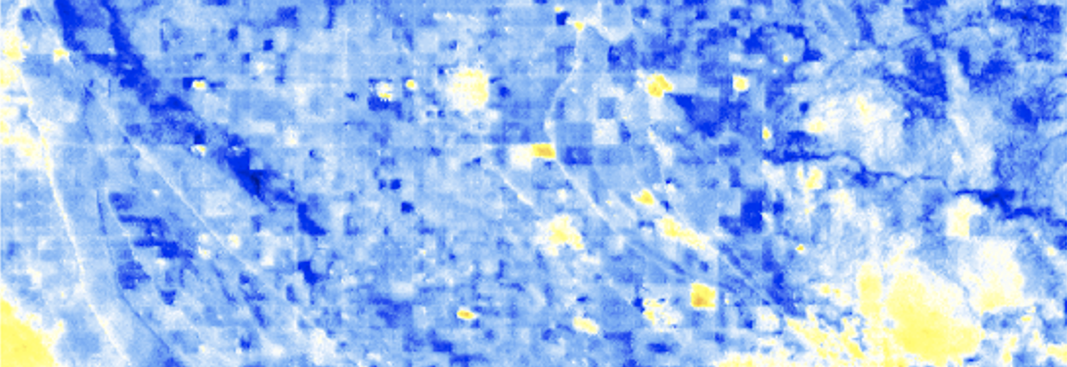
Mosquito-borne disease risk mapping at high spatial and temporal resolutions using remotely sensed land surface temperature measurements
Anna Boser¹
Daniel Sousa²
Ashley Larsen¹
Andrew MacDonald³
¹Bren School of Environmental Science and Management, UC Santa Barbara, Santa Barbara, CA, USA
²Jet Propulsion Laboratory, California Institute of Technology, Pasadena, CA, USA
³Earth Research Institute, UC Santa Barbara, Santa Barbara, CA, USA

Slide 2
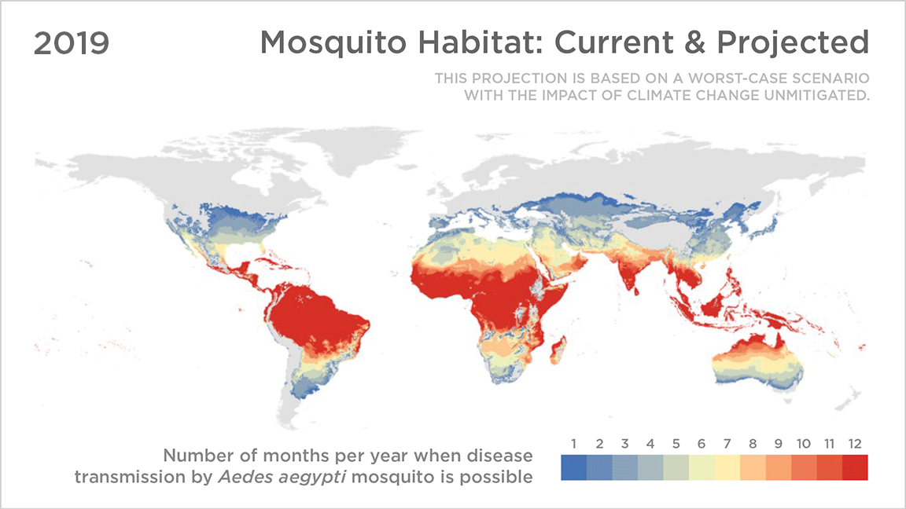
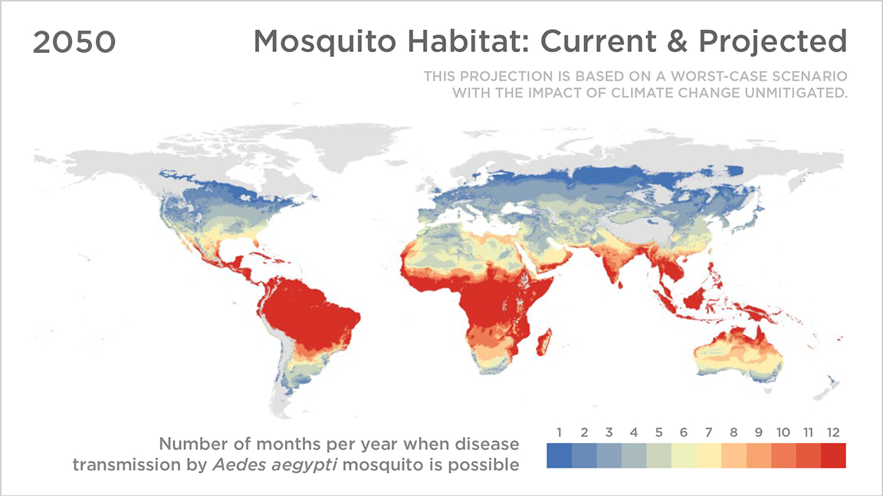
Mosquito-borne disease
Mosquito-borne diseases (MBDs) threaten 80%+ of the world’s population¹
Temperature is an important determinant of MBD risk²
Introduction
Conclusion
Methods
Analysis
¹Ebi, K. L., Boyer, C., Ogden, N., Paz, S., Berry, P., Campbell-Lendrum, D., Hess, J. J., & Woodward, A. (2021). Burning embers: Synthesis of the health risks of climate change. Environmental Research Letters. https://doi.org/10.1088/1748-9326/abead
²Mordecai, E. A., Caldwell, J. M., Grossman, M. K., Lippi, C. A., Johnson, L. R., Neira, M., Rohr, J. R., Ryan, S. J., Savage, V., Shocket, M. S., Sippy, R., Ibarra, A. M. S., Thomas, M. B., & Villena, O. (2019). Thermal biology of mosquito-borne disease. Ecology Letters, 22(10), 1690–1708. https://doi.org/10.1111/ele.13335
Source: Sadie J. Ryan, Colin J. Carlson, Erin A. Mordecai, and Leah R. Johnson
Credit: Koko Nakajima/NPR
Notes:
MBD is an important contributor to the global burden of disease; 80% world’s pop
Getting worse with CC because:
Temperature really important bc mosquitos are very temperature sensitive – temperature affects everything in the mosquito life cycle from larval survival to adult lifespan as well as traits important to transmission such as mosquito biting rates and pathogen transmission rates
Bc of this, worse with CC.
30

Slide 3
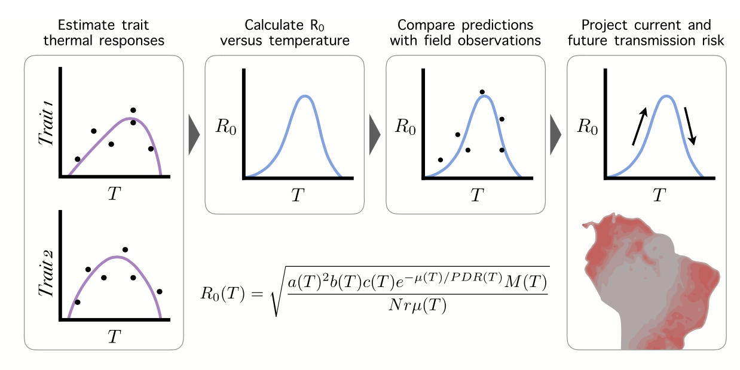
Risk maps from temperature-trait relationships
Pros: many traits including
Larval survival
Adult lifespan
Biting rate
Transmission probability
Cons: Coarse resolution
Introduction
Conclusion
Methods
Analysis
Mordecai, E. A., Caldwell, J. M., Grossman, M. K., Lippi, C. A., Johnson, L. R., Neira, M., Rohr, J. R., Ryan, S. J., Savage, V., Shocket, M. S., Sippy, R., Ibarra, A. M. S., Thomas, M. B., & Villena, O. (2019). Thermal biology of mosquito-borne disease. Ecology Letters, 22(10), 1690–1708. https://doi.org/10.1111/ele.13335
Notes:
Risk maps are really important for public health efforts surrounding MBD
One way of creating risk maps is by using mosquito responses to temperature calculated in the lab
This figure is pulled from a big synthesis by Mordecai et al that synthesizes a bunch of the known temperature-trait relationships.
Some examples of traits
You can use these to calculate R0 using this complicated equation you really don’t need to worry about and then validate it
This approach works pretty well and is fairly common, but because our measurements of temperature tend to be pretty coarse, these maps tend to be coarse and on large scales

Slide 4
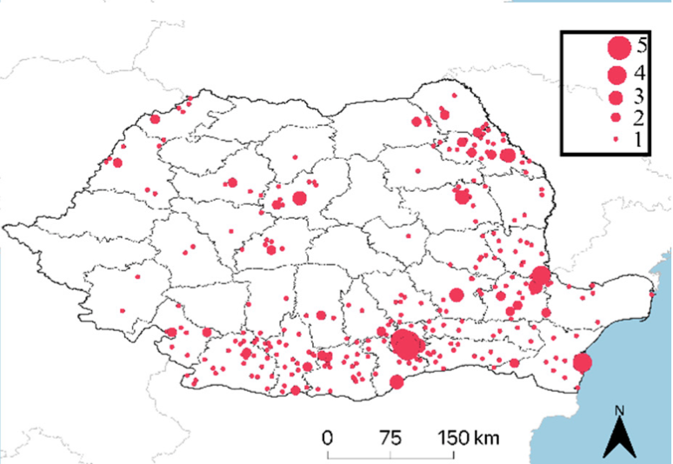
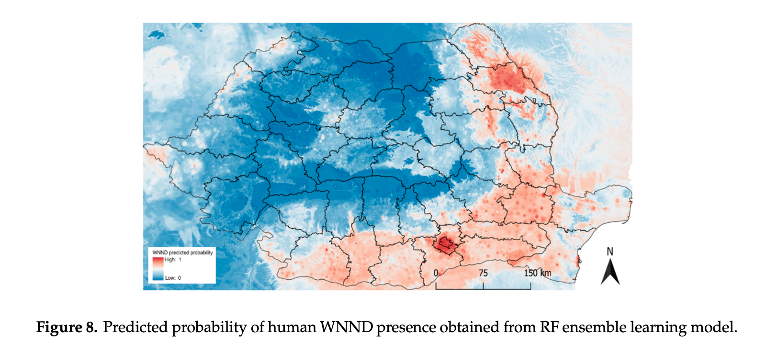
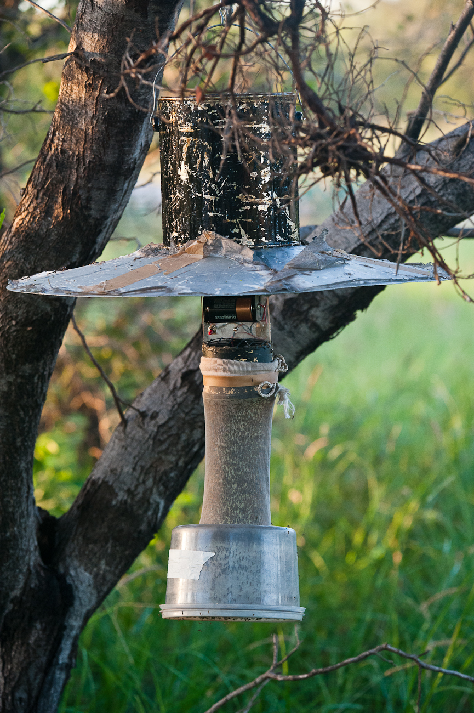
Local risk maps
Local monitoring
Mosquito traps
Human cases
Extrapolate to maps of abiotic and biotic factors
Introduction
Conclusion
Methods
Analysis
Human cases in Romania 2015-2019
Coroian, M., Petrić, M., Pistol, A., Sirbu, A., Domșa, C., & Mihalca, A. D. (2020). Human West Nile Meningo-Encephalitis in a Highly Endemic Country: A Complex Epidemiological Analysis on Biotic and Abiotic Risk Factors. International Journal of Environmental Research and Public Health, 17(21). https://doi.org/10.3390/ijerph17218250
Source: Government of Western Australia Department of Health
Notes:
More local public health efforts are therefore left to some different approaches.
Mosquito traps and human case data help us get a general understanding of the understanding of risk, and as you can see here you can try to use such data to try to build models that fill in the gaps
Problem here is that it’s hard to uncover true relationships bc of sparse and noisy data
Also you don’t know everything – ex you know how many mosquitos there are but not biting or transmission rates
Would be nice to complement this with the mechanistic understandings we have
3

Slide 5
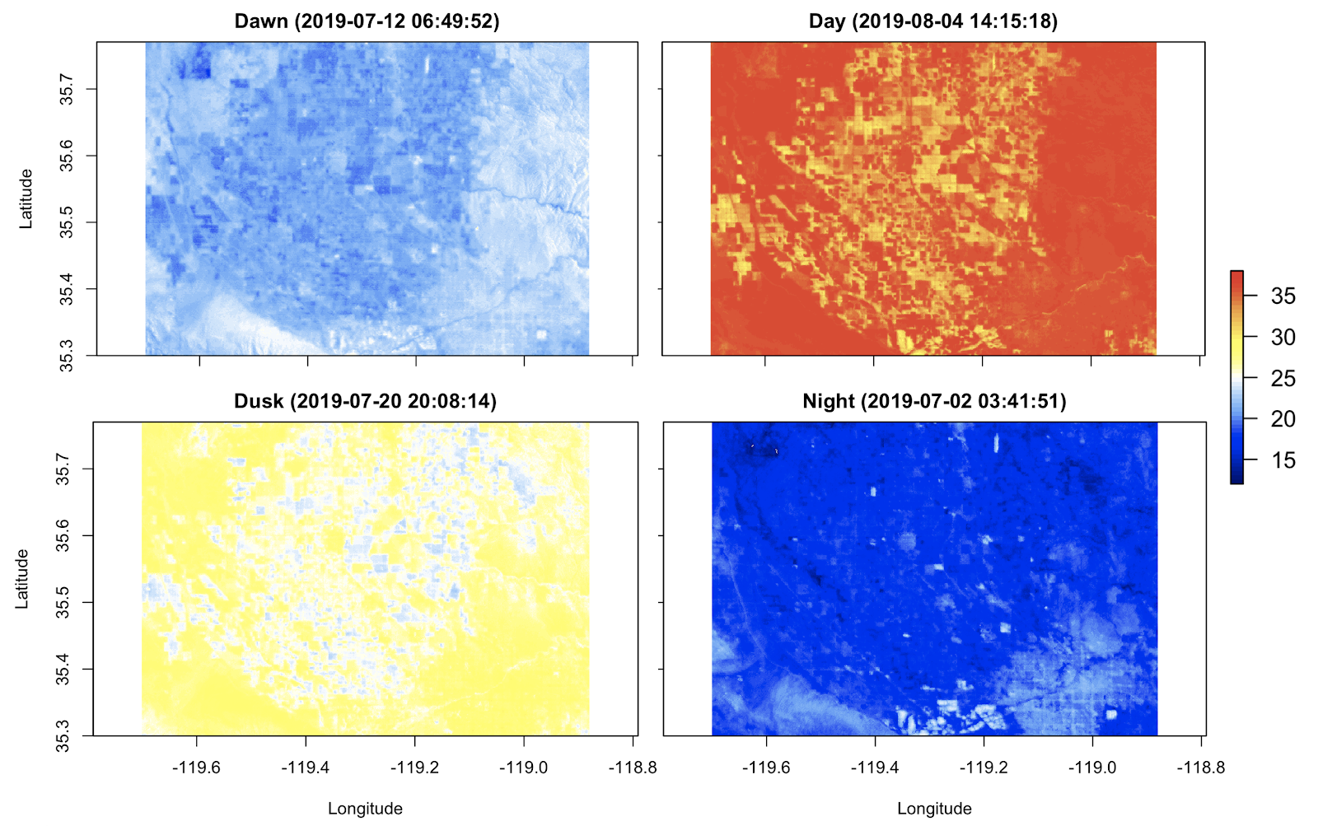
Fine resolution risk maps from temperature-trait relationships
Examples of ECOSTRESS 70m resolution Land Surface Temperature (LST) images over varying times of day
Fine resolution risk maps
High resolution temperature maps
Temperature-risk relationships
Introduction
Conclusion
Methods
Analysis
Boser AS, Sousa D, Larsen A, MacDonald A. “Mosquito-borne disease risk mapping at high spatial and temporal resolutions using remotely sensed land surface temperature measurements.” Environmental Research Letters. (In review).
Notes:
What we’re going to do is take advantage of the newly available ECOSTRESS satellite which gives us 70m resolution LST measurements at variable times of day to take the mechanistic approach with lab-derived mosquito trait equations
Specifically, we’re going to look at biting rate and transmission rate in order to do a case study, and see what variability we can recover over space and time and different landscapes. We’re also going to look at if this variability is significant enough to cause bias if instead of taking into account variability we simply took the coarser averages. This would be the case because of Jensen’s inequality which is a phenomenon that happens when applying deeply nonlinear relationships to averaged data.
Explain with picture
4

Slide 6
Methods
Case study of West Nile virus in California’s San Joaquin Valley
Culex Tarsalis biting rates and West Nile virus transmission probability
Land Surface Temperature
Air temperature modeling
Air Temperature
Laboratory derived equations
Diurnal cycle & landcover analysis
Biting and transmission rates
Introduction
Conclusion
Methods
Analysis
R² = 0.85
Notes:
We’re going to be doing a case study in SJ valley.
In order to take advantage of ECOSTRESS LST we first have to transform LST to air temperature. We followed the lead of some similar studies doing with with MODIS and end up with an R2 of 0.85.
Once we have air temperature we can apply the biting and transmission rate equations for the major vector in the region: Culex Tarsalis
We can look at how these vary through time and over different landcovers, as well as if this variation means that coarser temperature measurements will lead to bias

Slide 7
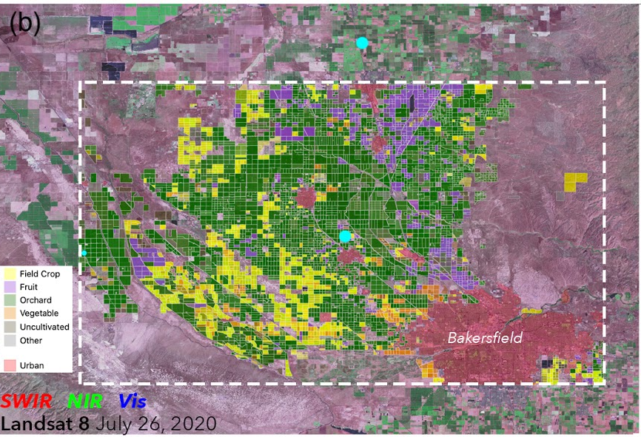
Study site: Bakersfield, CA
Will the wide range in daily temperatures and landcovers cause significant variations in biting and transmission rates?
Will the averaging the air temperature data (analogous to using coarse data) lead to biased risk estimates?
Introduction
Conclusion
Methods
Analysis
Notes:
6:30

Slide 8
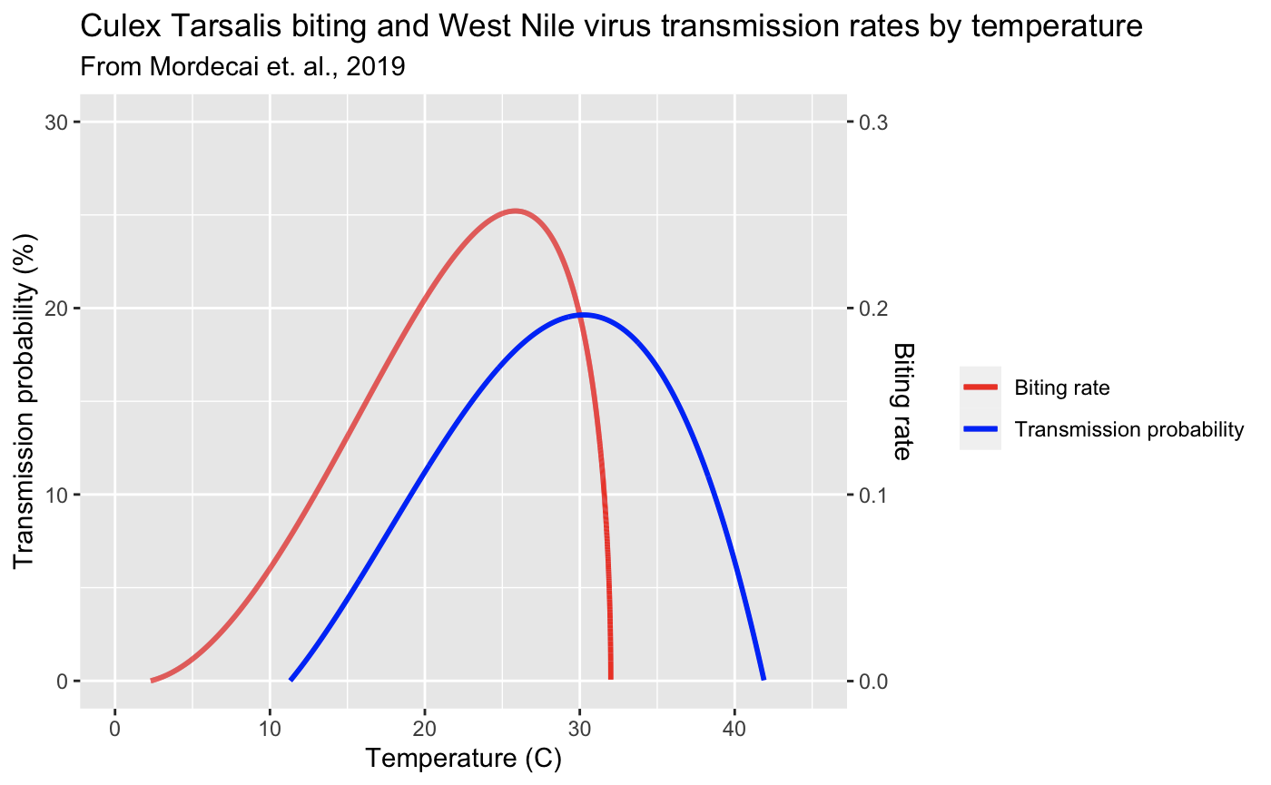
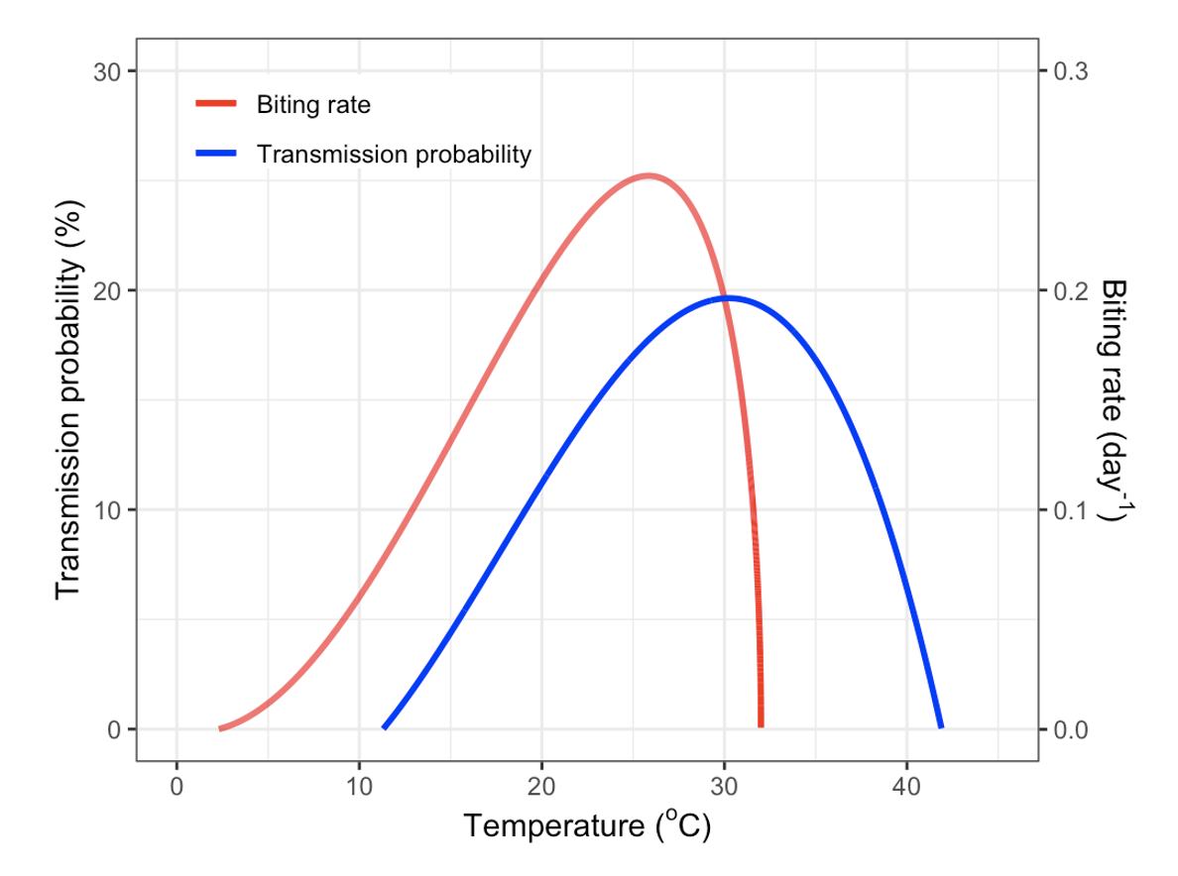
Biases when using averaged temperatures (Jensen’s inequality)
Spatially averaged temperatures result in:
Biting rates being overestimated by 0.063 day⁻¹, or 24.9% of the possible range in values (p-value < 0.05).
Transmission probabilities being overestimated by 3.3%, or 16.8% of the possible range in values (p-value < 0.05).
Introduction
Conclusion
Methods
Analysis
Boser AS, Sousa D, Larsen A, MacDonald A. “Mosquito-borne disease risk mapping at high spatial and temporal resolutions using remotely sensed land surface temperature measurements.” Environmental Research Letters. (In review).

Slide 9
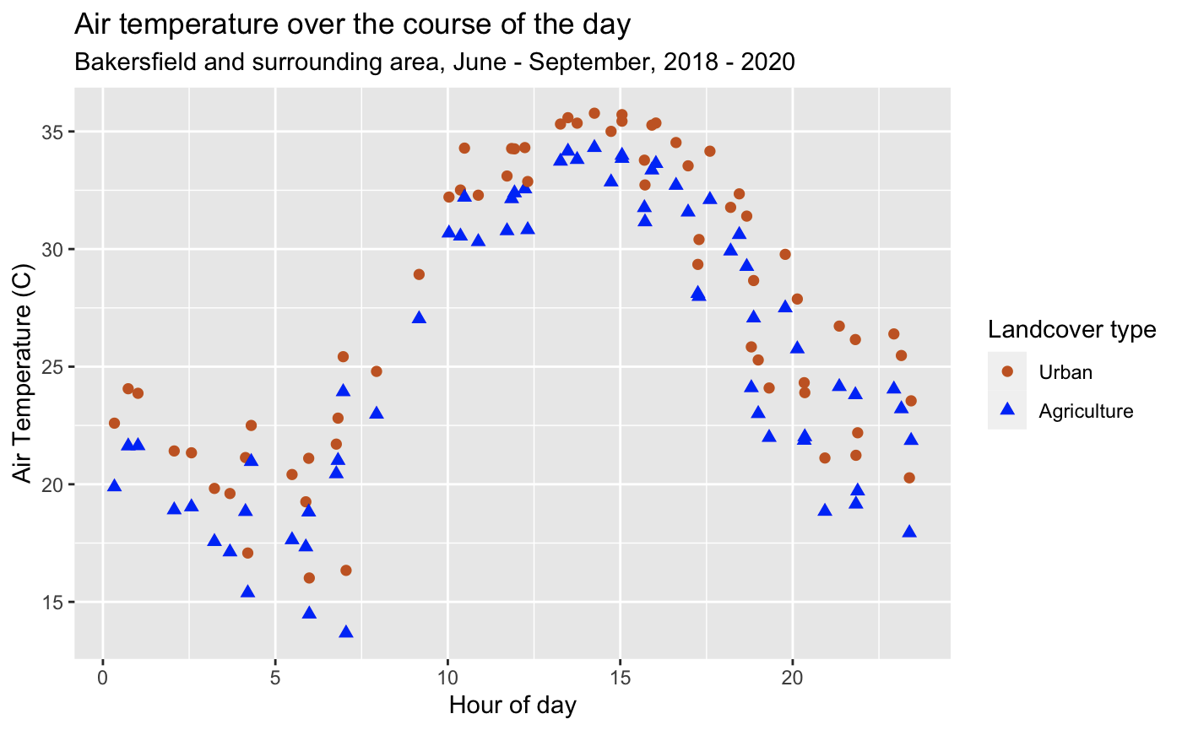
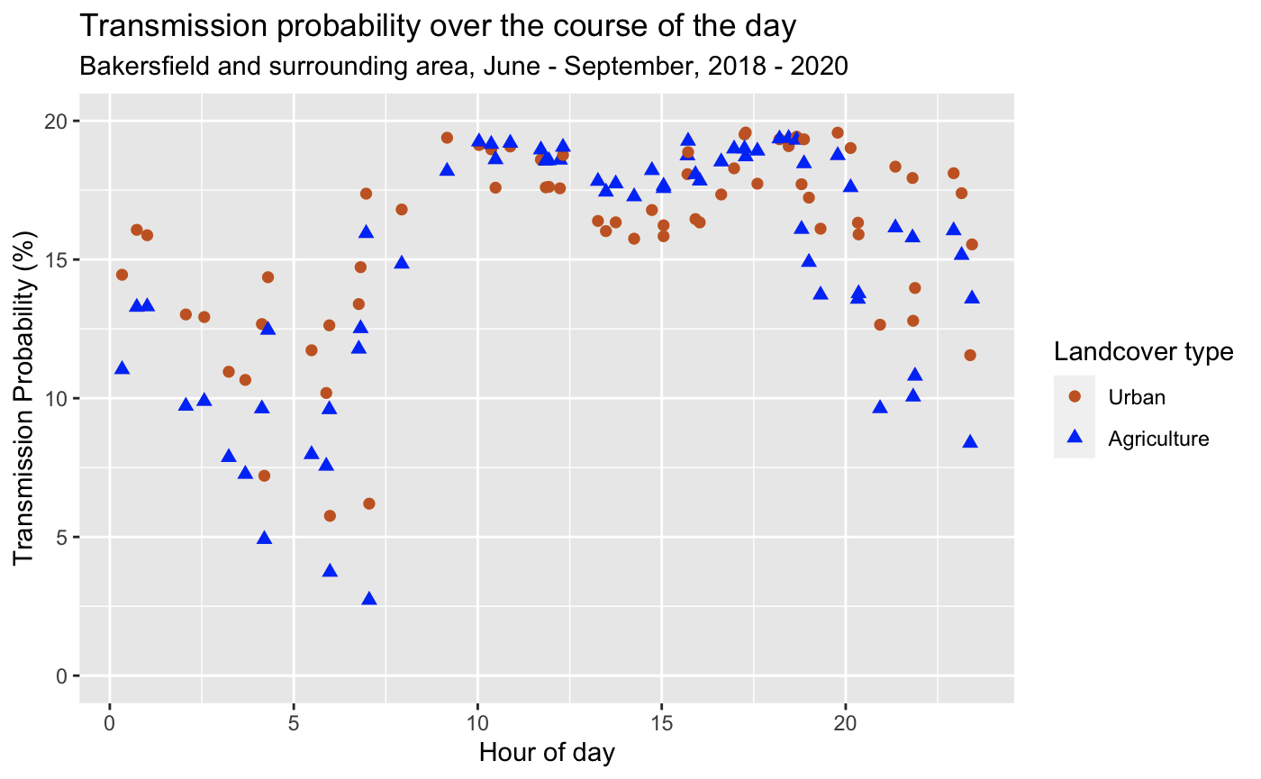
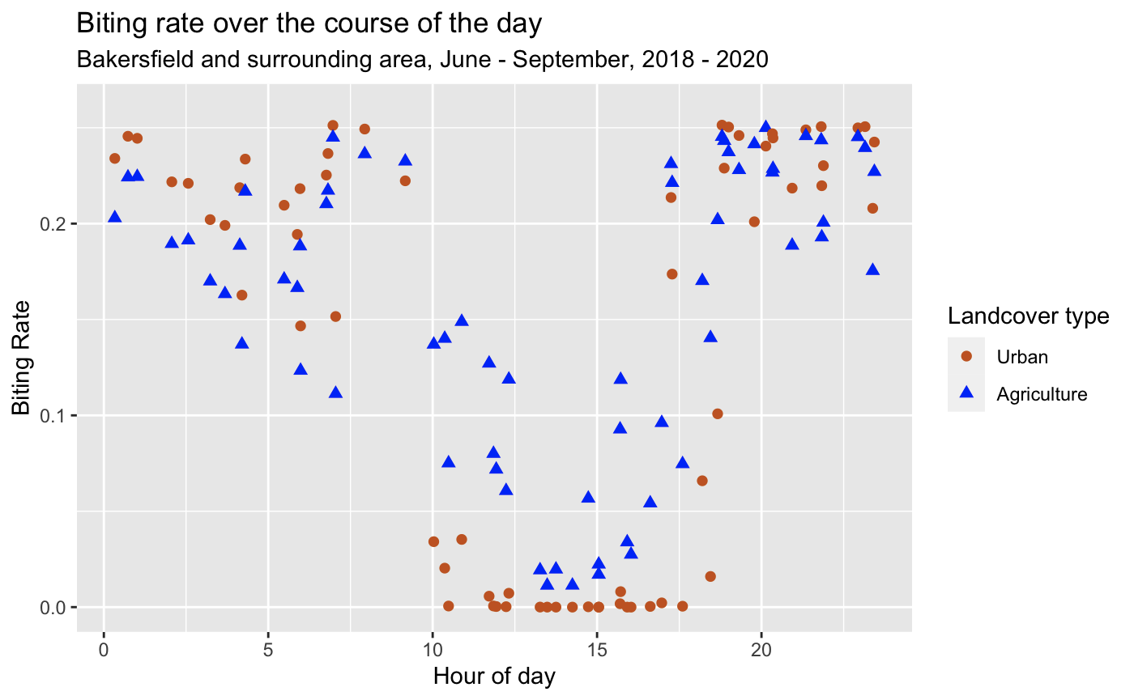
Spatio-temporal variation
Urban areas have higher air temperatures than agricultural areas by an average of 2.0 C (p-value < 0.05).
Higher transmission probability in urban areas (p-value < 0.05).
Lower biting rate in urban areas (p-value < 0.05).
Air temperature (C)
Introduction
Conclusion
Methods
Analysis
Biting rate
Transmission probability

Slide 10
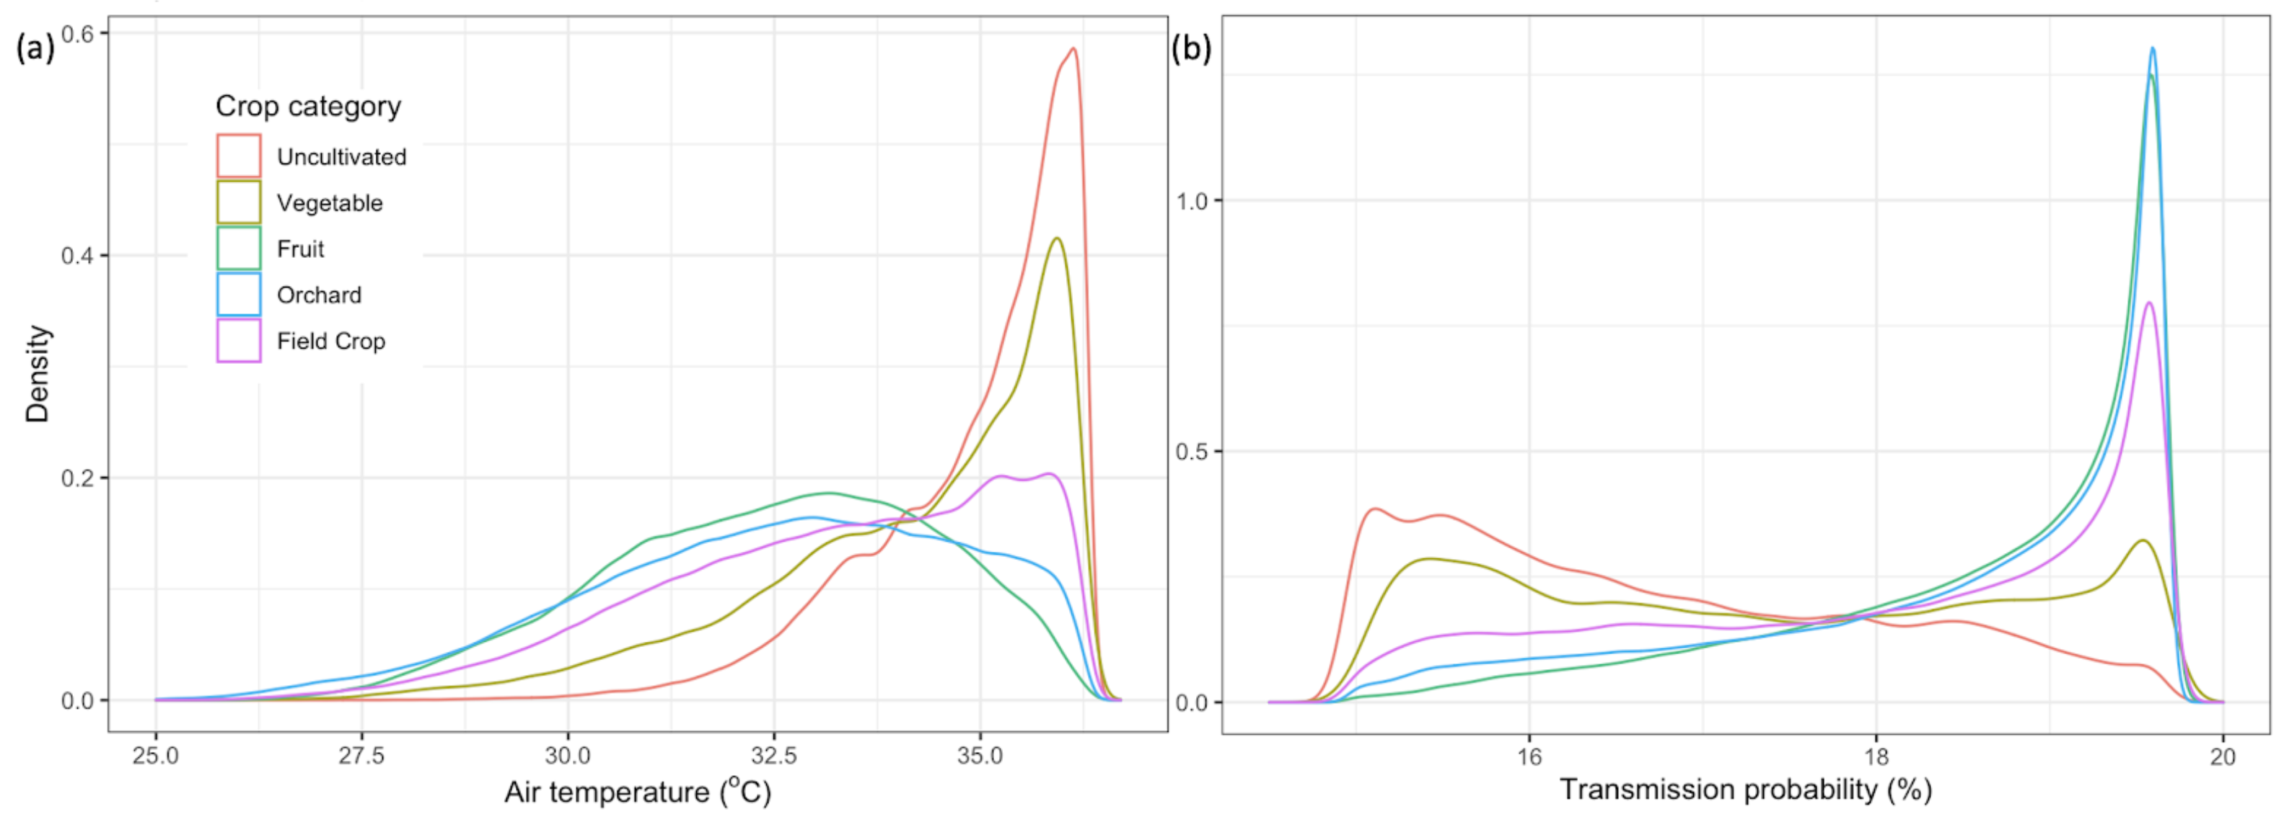
Spatio-temporal variation
Daytime air temperature and WNV transmission probability distributions by crop type.
Introduction
Conclusion
Methods
Analysis
Boser AS, Sousa D, Larsen A, MacDonald A. “Mosquito-borne disease risk mapping at high spatial and temporal resolutions using remotely sensed land surface temperature measurements.” Environmental Research Letters. (In review).

Slide 11
Conclusion
Different landcovers and different times of day represent different biting and transmission rates
The nonlinearity of the temperature-trait relationships means that coarse or averaged air temperature measurements lead to biased risk estimates
Such information can be used to better target local WNV mitigation and prediction or to improve larger scale studies affected by Jensen’s inequality
Introduction
Conclusion
Methods
Analysis

